Slide 1
Central Processing Unit
Unit 5

Slide 2
CPU
Process Bulk Data
Three parts
CU-Supervises the transfer of information among registers and instruct the ALU to perform instruction.
ALU-Perform Arithmetical and logical operation.
Register set- Stores Intermediate Data

Slide 3
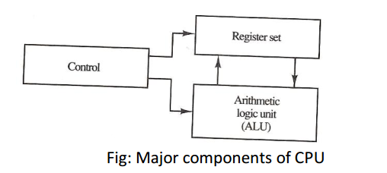

Slide 4
General Register Organization
Memory are needed
To stores intermediate data
Partial product of multiplication
Temporary results and many more
Accessing memory is time consuming operations
So registers are used and are at CPU
CPU contains large set of registers connected through common bus.

Slide 5
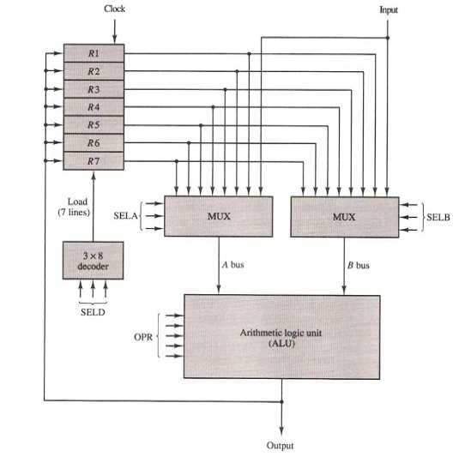

Slide 6
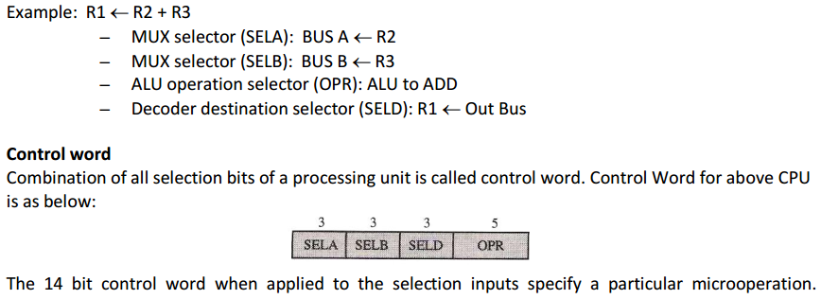

Slide 7
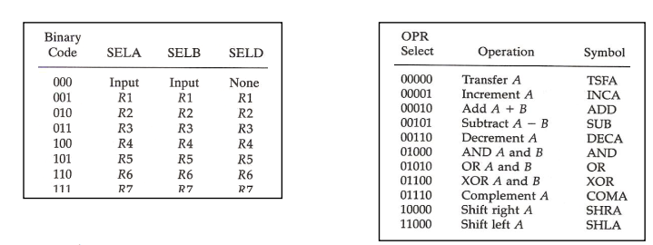

Slide 8
Stack Organization
CPU included Storage devices that are implemented in LIFO manner i.e Stack
2 operation of Stack are PUSH(Insert) and POP(Deletion).
Register that store Stack Address is called Stack Pointer, it points top of Stack.
In computer the PUSH And POP operation are simulated by just incrementing and decrementing Stack pointer.

Slide 9
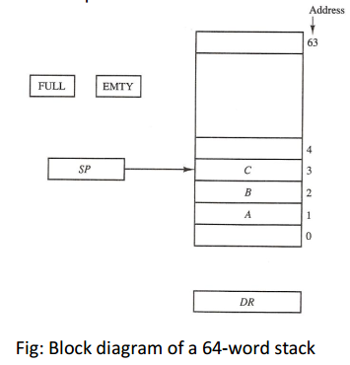
Register Stack

Slide 10
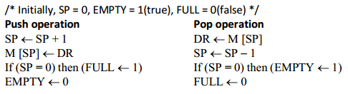

Slide 11
Memory Stack
A Stack is standalone unit
Or can be implemented in a Random Access Memory Attached to a CPU
A portion of memory is assigned to Stack operation using processor register as stack pointer

Slide 12
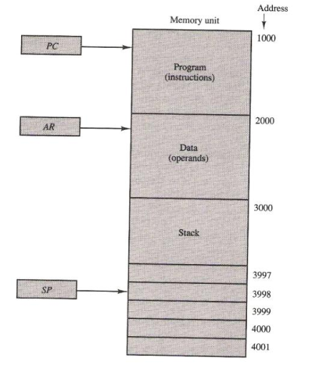

Slide 13
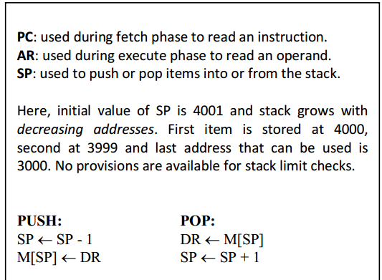

Slide 14
Stack Limits
For Stack overflow and stack underflow
Stack limit can be checked by using two processor register
One to hold the upper limit (3000)
One to hold the lower limit (4001)
After push, SP is compared with upper limit and after POP it is compared with lower limit.

Slide 15
Instruction Format
Computer instruction have specific format and usually contains three different fields.
1. Operation field that specifies the operation to be performed.
2. An address field that designates a memory address or a processor register.
3. A mode field that specifies the way the operand or the EA is determined.

Slide 16
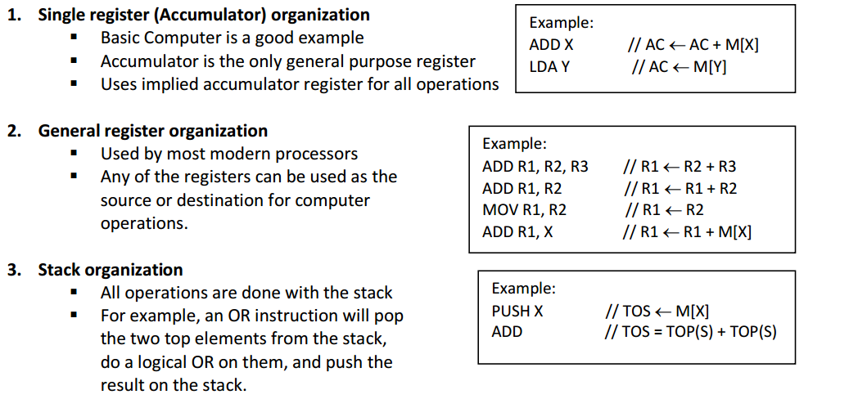
Processor Organization

Slide 17
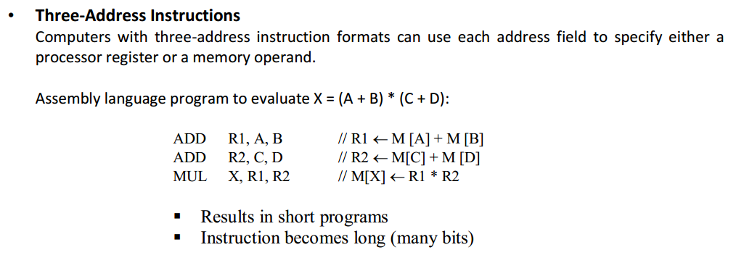

Slide 18
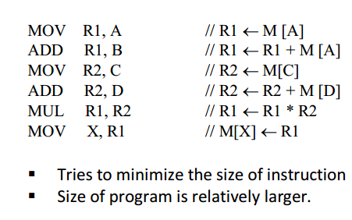
Two-Address Instructions These instructions are most common in commercial computers. Program to evaluate X = (A + B) * (C + D):

Slide 19
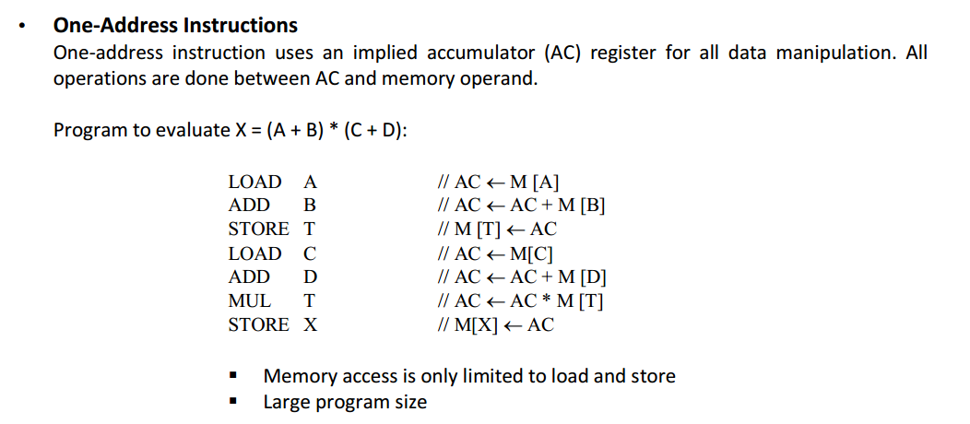

Slide 20
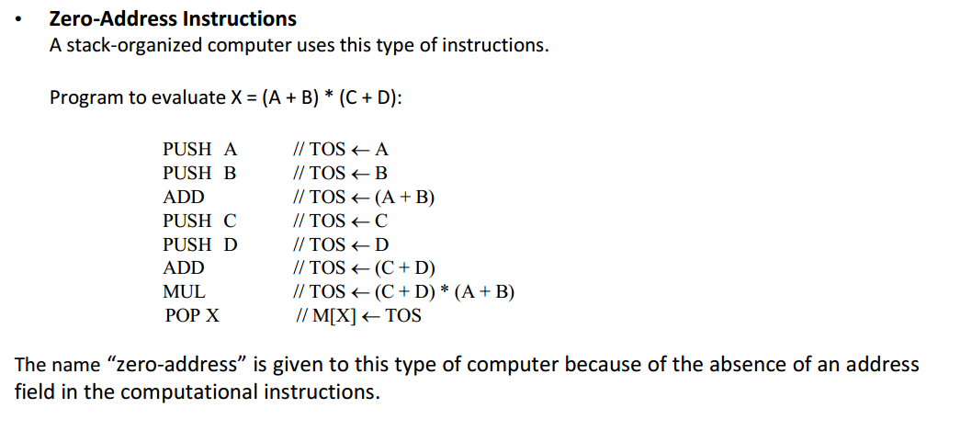

Slide 21
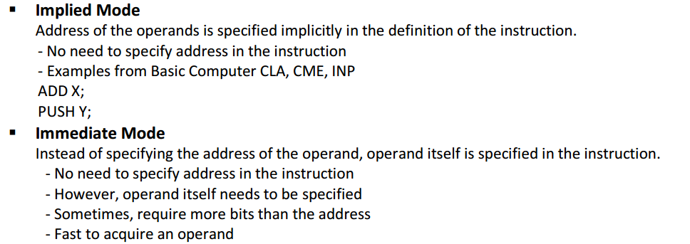
Addressing modes

Slide 22
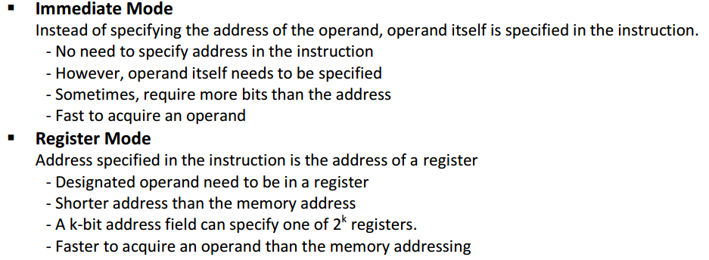

Slide 23
Register Indirect Mode
Instruction specifies a register in CPU whose content give the address of the operand in memory.
Uses fewer bit in address field of instruction because register address uses fewer bit than memory address.

Slide 24
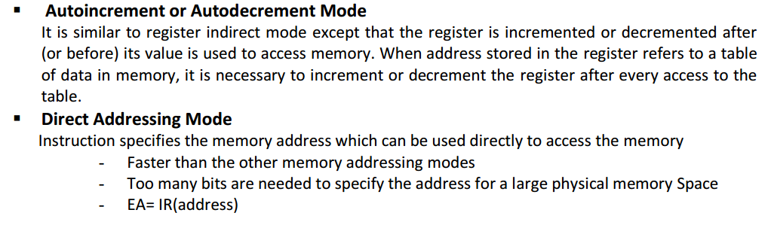

Slide 25
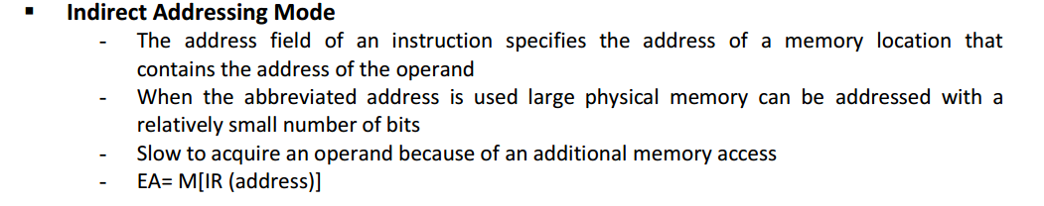

Slide 26
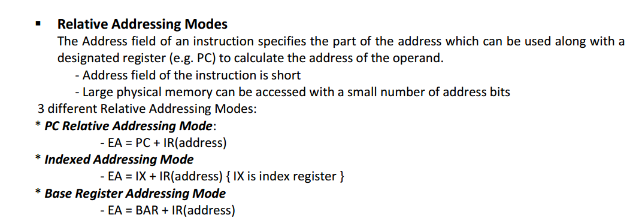

Slide 27
Indexed Addressing mode
Content of index register is added to the address part of the instruction to obtain effective address.{EA=IR(Address)+IX)}
Index register contain index value.
Address field define beginning address of data array.
The distance between the beginning of address and the address of the operand is index value stored in the index register.
The index register can be increment to access consecutive data.

Slide 28
Base register indexing
Base register contains base address.
Base register is added to address part of instruction to find effective address.
Used in program relocation.
In program relocation- a base register the displacement value of instruction is not changed, only base register value is updated.

Slide 29
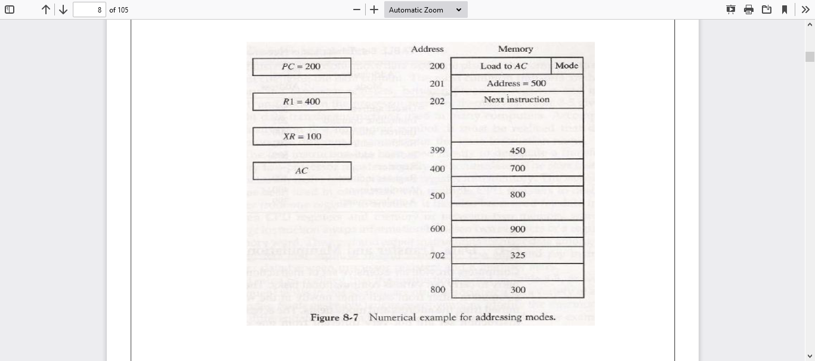

Slide 30
Basic Instructions Set
Computer provide various instruction set to carry out various computational tasks.
Instruction set differ from computer to computer---with operand determination by using mode bits and address.
Every computers instruction sets are similar instead they may have different binary coding or symbolic representation.
There are sets of computer instructions which are as follows:

Slide 31
Basic Instruction sets
Data transfer instructions
Use for transferring data from one location to other without changing the content.
Data manipulation Instructions
This instructions implements arithmetic, logic, and shift operations.
Program control instructions
This instruction provide decision making capabilities and change path taken by the program when executed in the computer.

Slide 32
Data Transfer Instructions
between memory and processor registers
between processor registers and I/O
between processor register themselves

Slide 33
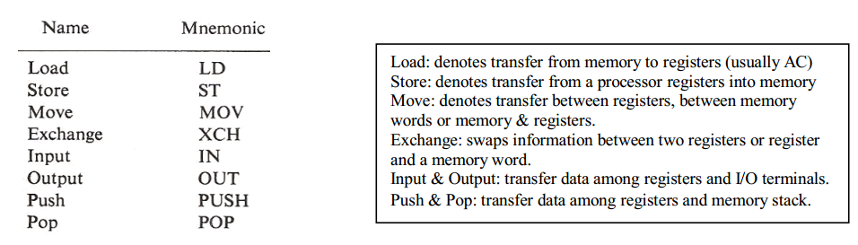
Data Transfer Instructions

Slide 34
Data Manipulation
Data manipulation instructions provide computational capabilities for the computer. These are divided into 3 parts: 1. Arithmetic instructions 2. Logical and bit manipulation instructions 3. Shift instructions

Slide 35
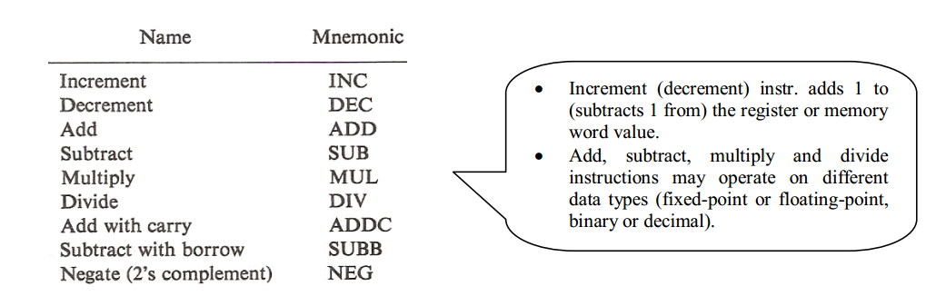
Arithmetic Operations

Slide 36
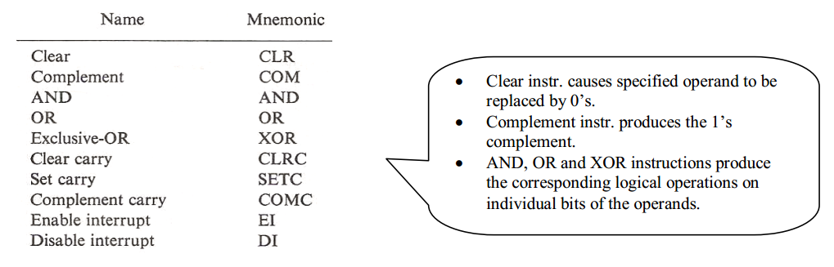
Logical and Bit Manipulation

Slide 37
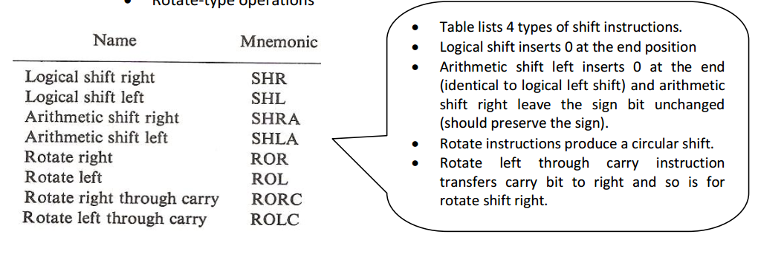
Shift Microoperations

Slide 38
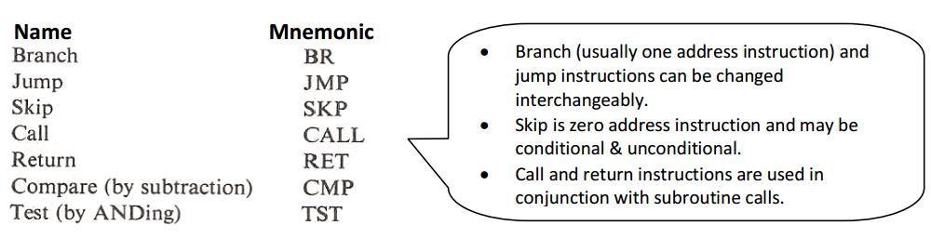
Program Control Instruction

Slide 39
Program control
Program may execute in sequence
PC value is incremented every time and after one instruction is execute next in sequence instruction is fetched , decode and execute.
After again next instruction is fetched and so on.
Program may execute out of sequence
A program control type of instruction, when executed may change the value of program counter and cause the flow of control to be altered.
This cause break in sequence of execution.
Program control is Important feature as it provides control over the flow of program execution and a capability for branching to different segments.

Slide 40
Program Control Instruction

Slide 41
Branch and jump instructions are used for conditional and unconditional.
An unconditional branch causes instruction to branch to address specify in instructions without any condition.
The conditional branch instruction specify a condition to be true or false.
If condition is met , the PC is loaded with address specify in instruction or branch address.
If condition fails the next instruction is executed.

Slide 42
The skip instruction doesn’t need an address field therefore it is zero address instruction
A conditional skip instruction will skip the next instruction if condition is met.
It is accomplished by incrementing the PC value.

Slide 43
Status bit condition
It is sometime convenient to supplement ALU with status register where status condition are stored.
Status bit are also called flag bit or condition code.
The four status bit are V,Z,S and C.
The bit are set or cleared according to operation performed by ALU.

Slide 44
Bit C (carry) is set to 1 if the end carry C8 is 1. It is cleared to 0 if the carry is O.
Bit S (sign) is set to 1 if the highest-order bit F7 is 1. It is set to 0 if the bit is 0.
Bit Z (zero) is set to 1 if the output of the ALU contains all 0's.In other words, Z = 1 if the output is zero and Z = 0 if the output is not.
Bit V (overflow) is set to 1 if the exclusive-OR of the last two carries is equal to 1, and Cleared to 0 otherwise. This is the condition for an overflow when negative numbers are in 2's complement.

Slide 45
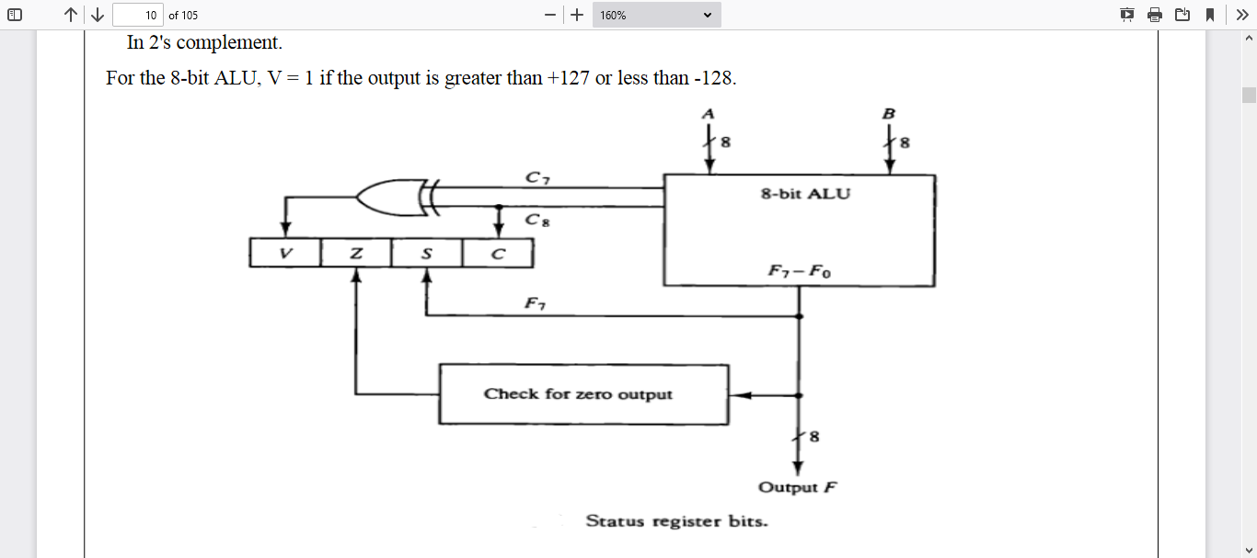

Slide 46
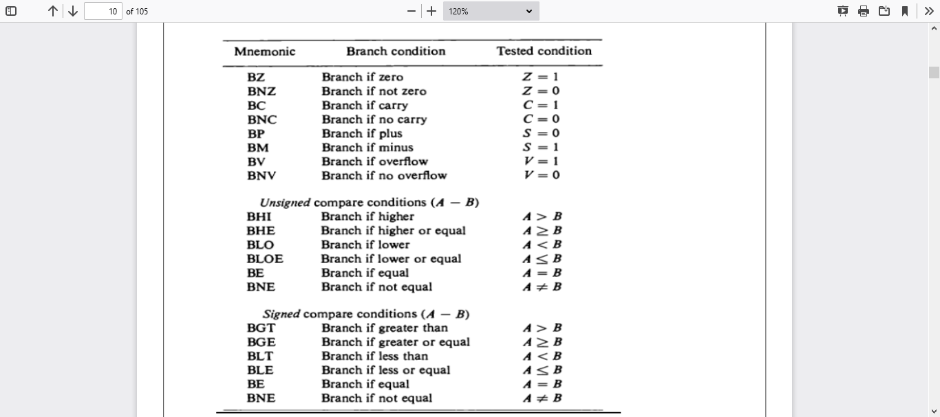

Slide 47
Subroutine Call and Return
A subroutine is a self-contained sequence of instructions that performs a given computational task.
The instruction that transfers program control to a subroutine is known by different names. The most common names used are call subroutine, jump to subroutine, branch to subroutine, or branch and save address.
The instruction is executed by performing two operations:

Slide 48
The address of the next instruction available in the program counter (the return address) is Stored in a temporary location so the subroutine knows where to return.
Control is transferred to the beginning of the subroutine. Different computers use a different temporary location for storing the return address. Some store the return address in the first memory location of the subroutine, some store it in a fixed location in memory, some store it in a processor register, and some store it in a memory stack.

Slide 49
The most efficient way is to store the return address in a memory stack. The advantage of using a stack for the return address is that when a succession of subroutines is called, the sequential return addresses can be pushed into the stack. The return from subroutine instruction causes the stack to pop and the contents of the top of the stack are transferred to the program counter.

Slide 50
A subroutine call is implemented with the following micro operations: SP ←SP - 1 Decrement stack pointer M [SP] ←PC Push content of PC onto the stack PC ← effective address Transfer control to the subroutine - If another subroutine is called by the current subroutine, the new return address is pushed into The stack and so on.
The instruction that returns from the last subroutine is implemented by the Micro operations: PC←M [SP] Pop stack and transfer to PC SP ←SP + 1 Increment stack pointer

Slide 51
Program Interrupt
Program interrupt refers to the transfer of program control from a currently running program to another service program as a result of an external or internal generated request.
Control returns to the original program after the service program is executed.
The interrupt procedure is, in principle, quite similar to a subroutine call except for three Variations:

Slide 52
(1) The interrupt is usually initiated by an internal or external signal rather than from the Execution of an instruction (except for software interrupt).
(2) The address of the interrupt service program is determined by the hardware rather than from the address field of an instruction.
(3) An interrupt procedure usually stores all the information

Slide 53
The state of the CPU at the end of the execute cycle (when the interrupt is recognized) is determined From: 1. The content of the program counter 2. The content of all processor registers 3. The content of certain status conditions - Program status word the collection of all status bit conditions in the CPU is sometimes called a program status word or PSW. The PSW is stored in a separate hardware register and contains the status information that characterizes the state of the CPU.

Slide 54
Types of Interrupts - There are three major types of interrupts that cause a break in the normal execution of a Program. They can be classified as: 1. External interrupts 2. Internal interrupts 3. Software interrupts - External interrupts come from input-output (I/O) devices, from a timing device, from a circuit monitoring the power supply, or from any other external source.

Slide 55
- Internal interrupts arise from illegal or erroneous use of an instruction or data. Internal interrupts are also called traps. Examples of interrupts caused by internal error conditions are register overflow, attempt to divide by zero, an invalid operation code, stack overflow, and protection violation. - A software interrupt is initiated by executing an instruction. Software interrupt is a special call instruction that behaves like an interrupt rather than a subroutine call. It can be used by the programmer to initiate an interrupt procedure at any desired point in the program.

